Slide 1
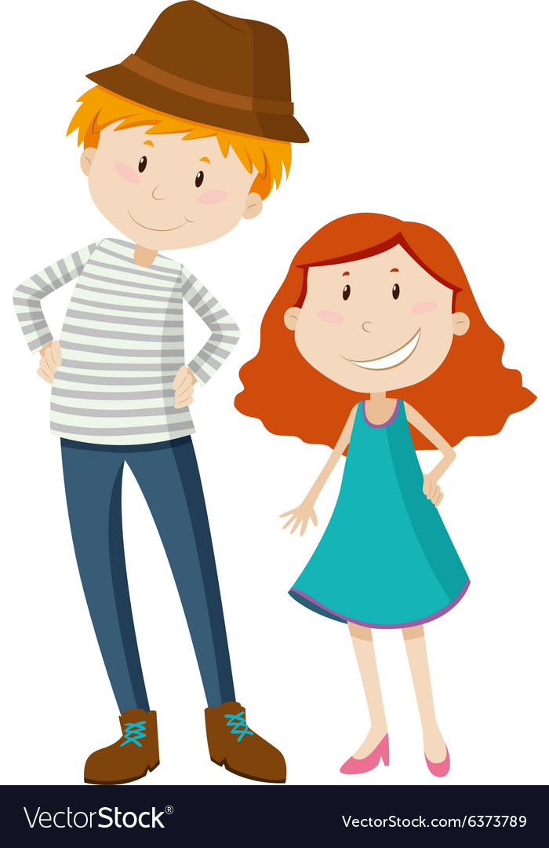
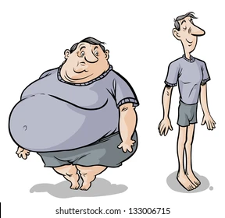
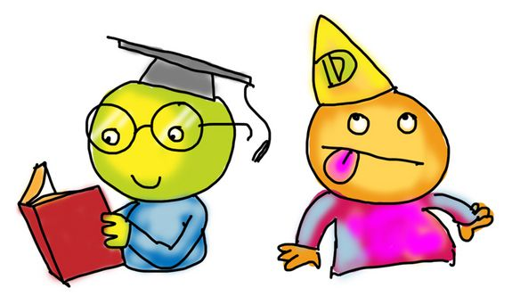
¿Cómo eres
tú?
7° Grado

Slide 2
Los objetivos
Al terminar esta leccción, las estudiantes deben:
Identify | Identify at least 10 descriptive adjectives in Spanish.
Describe | Describe themselves using the appropriate forms of adjectives.
Ask | Ask someone to describe him or herself using the structure -¿Cómo eres?-.
Use | Use adjectives appropriately according to number (amount) and gender.

Slide 3
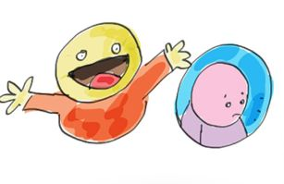
¿Cómo eres (tú)?
What does it mean literally?
Can you see how the meaning is formed?
What verb is used in the question?
How do you think you would reply?
Notes:
Explanation: Students answer the questions above.

Slide 4
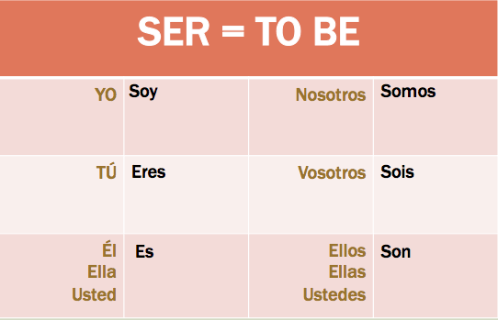
¡Repasemos!
For this topic, we will continue to use our new mejor amiga: el verbo SER

Slide 5

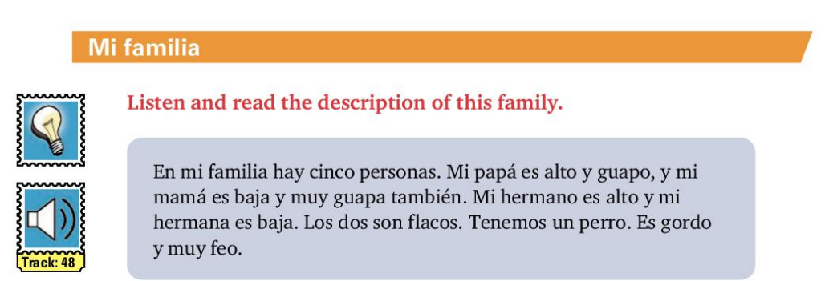
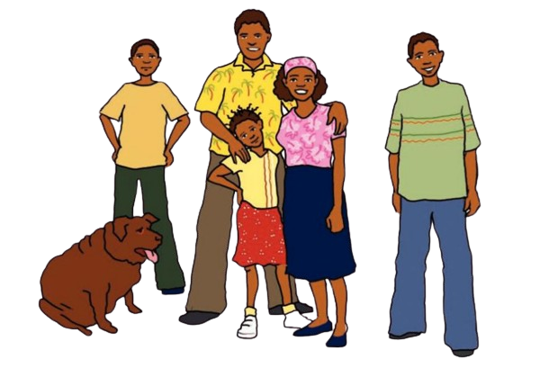
Vamos a leer y escuchar
En grupos de dos, identify the adjectives in this párrafo. What do you notice about the endings?
There is no subject pronoun here, but it still means he is!

Slide 6
Examinemos los adjetivos
Mi papá
Mi mamá
alto
guapo
baja
guapa
Adjectives in spanish are gender sensitive. Usually, when describing a male, the adjectives ends in o and when describing a female, the adjective ends with a.

Slide 7
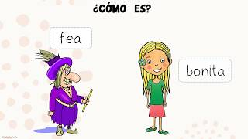
Notes:
The students will write the adjectives that they see in this video and write the english translation based on their understanding of what is displayed

Slide 8
Vamos a escribir
Now that we know a little more, let’s translate this paragraph.

Slide 9
La tarea: Adjetivos
Find the meaning of the following words and write the masculine and feminine form
alto✅
bajo ✅
gordo ✅
delgado
flaco ✅
moreno
negro
blanco
feo ✅
bonito ✅
inteligente
tonto
reservado
atrevido
deportista
artístico
trabajador
perezoso
estudioso
débil
fuerte
hablador
Notes:
Exploration: Students required to look up the above adjectives in preparation for next class.

Slide 10
Upcoming Assignments
Reading comprehension

Slide 11
¿Cómo eres
tú?
7° Grado
Semanas 2 - 4

Slide 12
La tarea: Adjetivos Let’s review
Find the meaning of the following words:
alto
bajo
gordo
delgado
flaco
Moreno (brown to light skin)
negra (dark-skinned)
Blanco (very light/white skinned)
feo
bonito
inteligente
tonto
reservado
atrevido
deportista
artístico
trabajador
perezoso
estudioso
débil
fuerte
hablador
What is the difference between these two lists?
Notes:
Exploration: Students required to look up the above adjectives in preparation for next class.

Slide 13
What have we noticed about some of the endings of the masculine and feminine forms of the adjectives?
Adjectives ending with consonants like ‘r’ become feminine by adding an ‘a’ to the end.
e.g. trabajador → trabajadora
Some adjectives are neutral. They can be both masculine and feminine without having any spelling changes. They normally end in ‘e’, ‘l’ or ‘-ista’
e.g. inteligente, deportista, débil

Slide 14
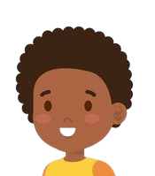
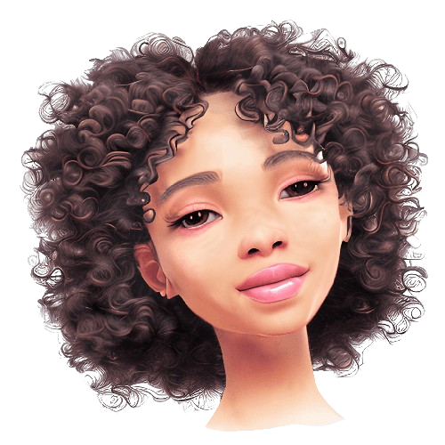
Soy…
¿Cómo eres?
Soy Pablo. Soy estudiante. Yo soy gordo y bajo. También, soy negro y guapo. Soy reservado y trabajador.
Soy Paola. Soy estudiante. Yo soy gorda y alta. Soy morena y bonita. Soy artística y deportista.

Slide 15
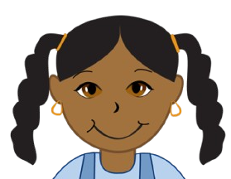
Soy…
¿Cómo eres?
alto
de media estatura
bajo
flaco
gordo
trabajador
fuerte
débil
alta
de media estatura
baja
flaca
gorda
trabajadora
fuerte
débil

Slide 16
What if you want describe yourself by saying something you are not?
No soy fea. Soy bonita

Slide 17
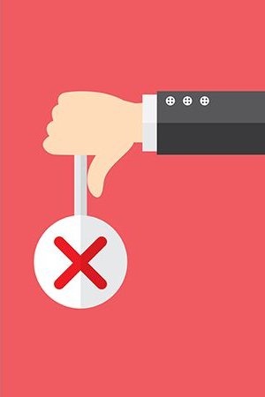
Negative Phrases
To make a sentence negative in Spanish, we place the word no before the conjugated verb.
e.g. Susana es mi hija. → Susana no es mi hija.
Somos débiles. → No somos débiles.

Slide 18
When listing TWO things that you are not, you don’t use y you use ni
No soy fea ni tonta.

Slide 19
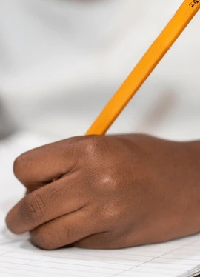
Vamos a escribir
Write a paragraph of 5 sentences about yourself. Two adjectives should describe how you look, and 2 adjectives should describe aspects of your personality. Write one sentence about one thing you are not.

Slide 20
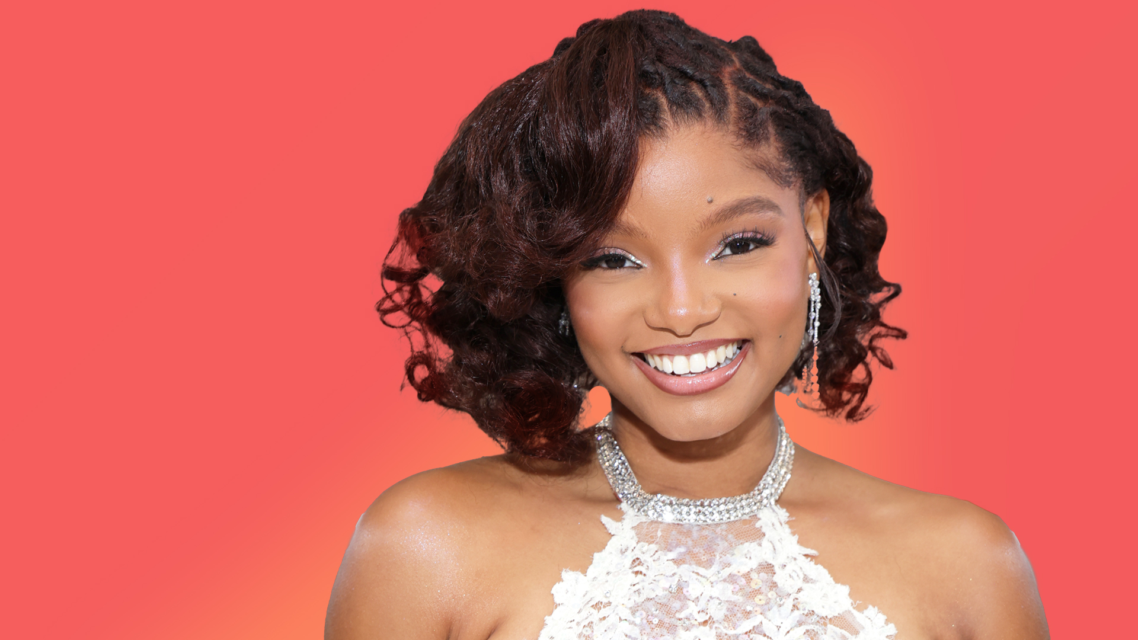
¿Quién es ella?
¿Cómo es ella?

Slide 21
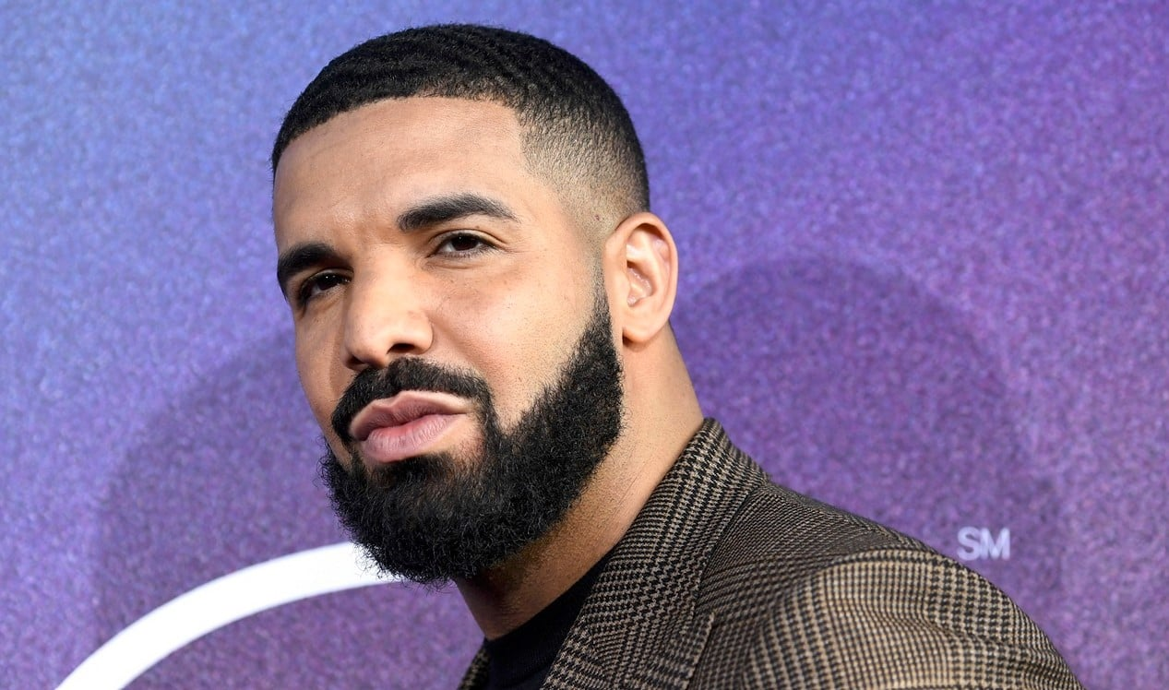
¿Quién es él?
¿Cómo es él?

Slide 22
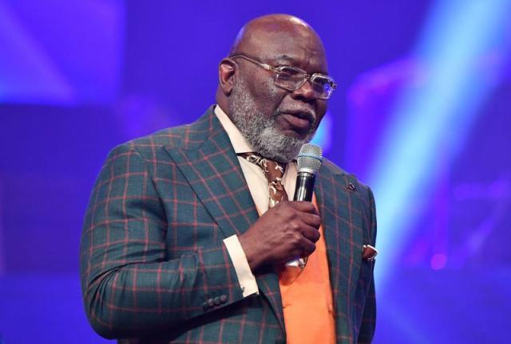
¿Quién es él?
¿Cómo es él?

Slide 23
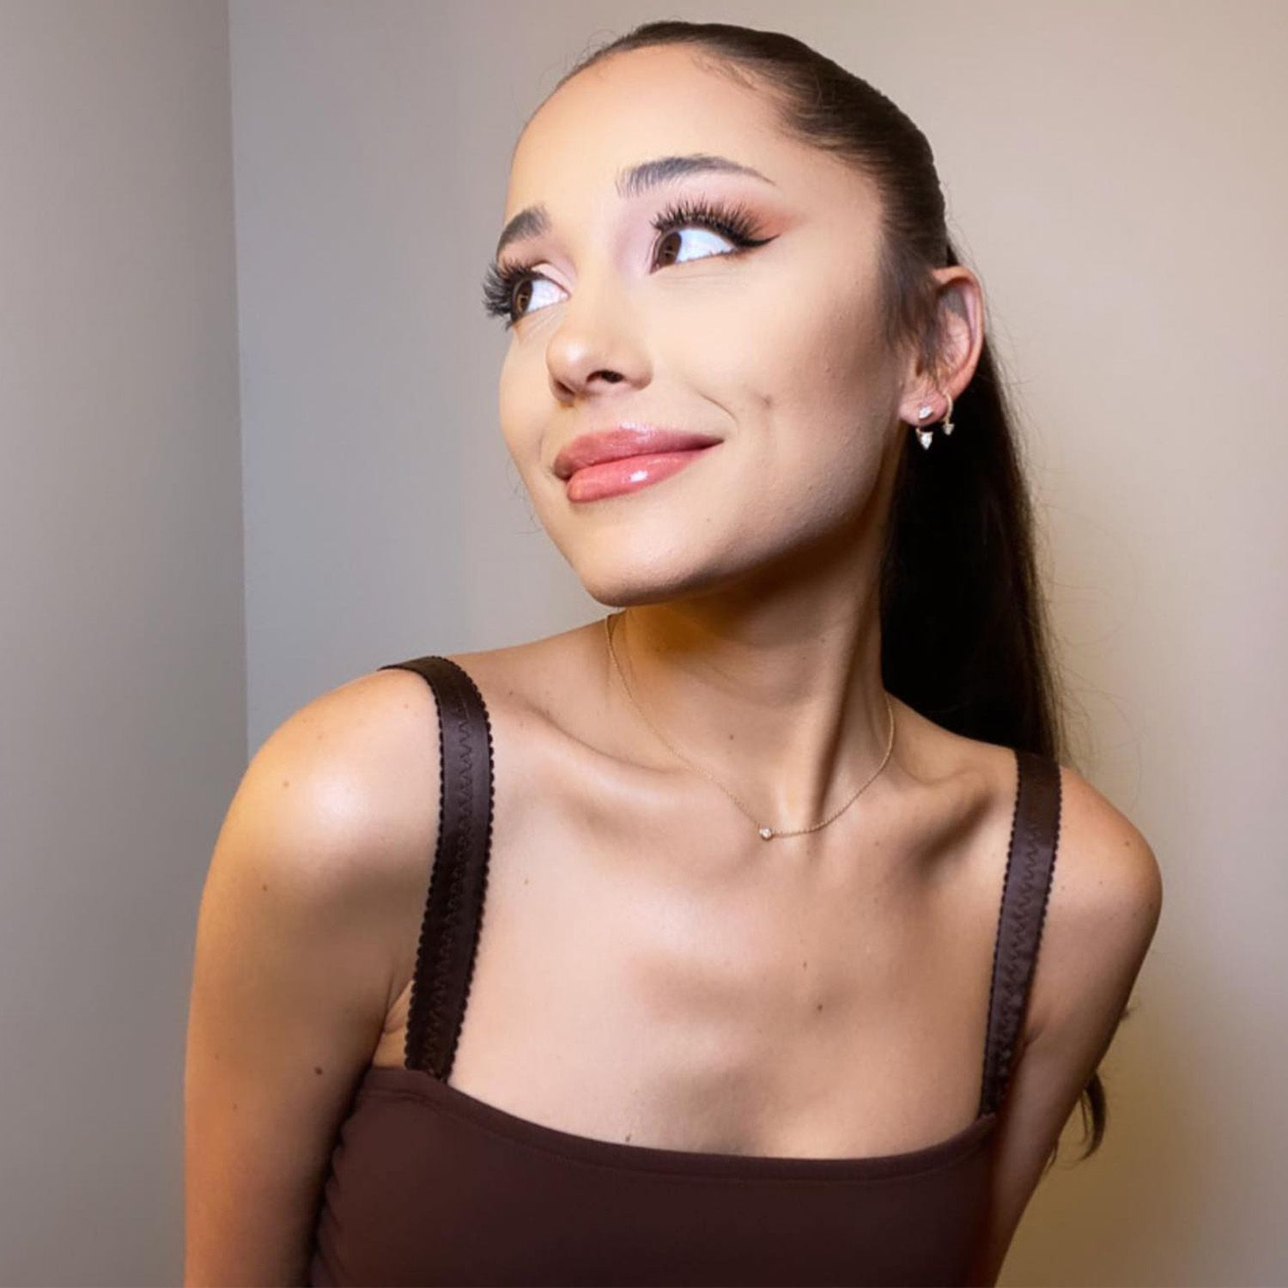
¿Quién es ella?
¿Cómo es ella?

Slide 24
¡Los opuestos!

Slide 25
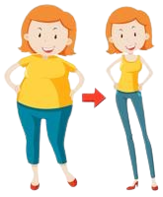
What word do I need to describe these women in ONE sentence
Notes:
Introduction of the word: pero

Slide 26
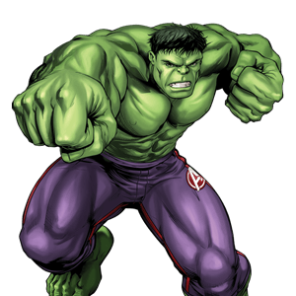
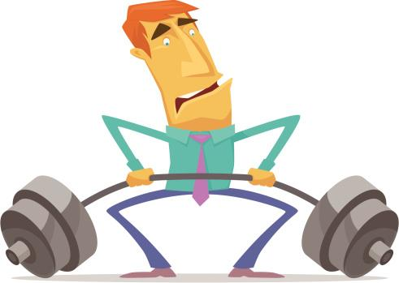

Slide 27
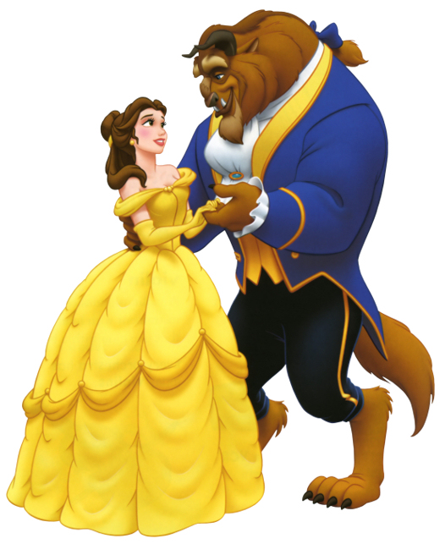

Slide 28
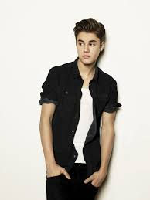
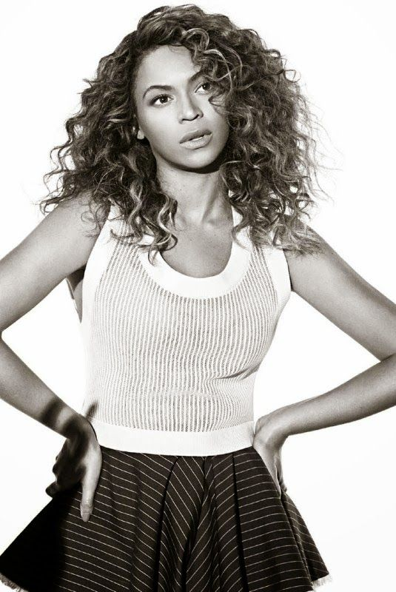

Slide 29
Scrap book entry #3
In your scrapbooks, you are to select 5 pairs of opposites. You are to find pictures that represent the opposite adjectives that you have selected. Then, you are to write ONE sentence for each pair that describes the difference between the two.
Notes:
Prompt students to talk about agreement with nouns,

Slide 30
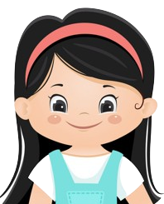
OR
Nosotros somos…
altos
trabajadores
inteligentes
débiles
Nosotras somos…
altas
trabajadoras
inteligentes
débiles

Slide 31
Spanish adjectives and Number
1. Adjectives ending with vowels can be made plural by adding ‘s’.
e.g. gordo → gordos
habladora → habladoras
fuerte → fuertes
2. Adjectives ending with consonants like ‘r’ and ‘l’ become plural by adding an ‘es’ to the end.
e.g. trabajador → trabajadores
débil → débiles
Notes:
Prompt students to talk about agreement with nouns,

Slide 32
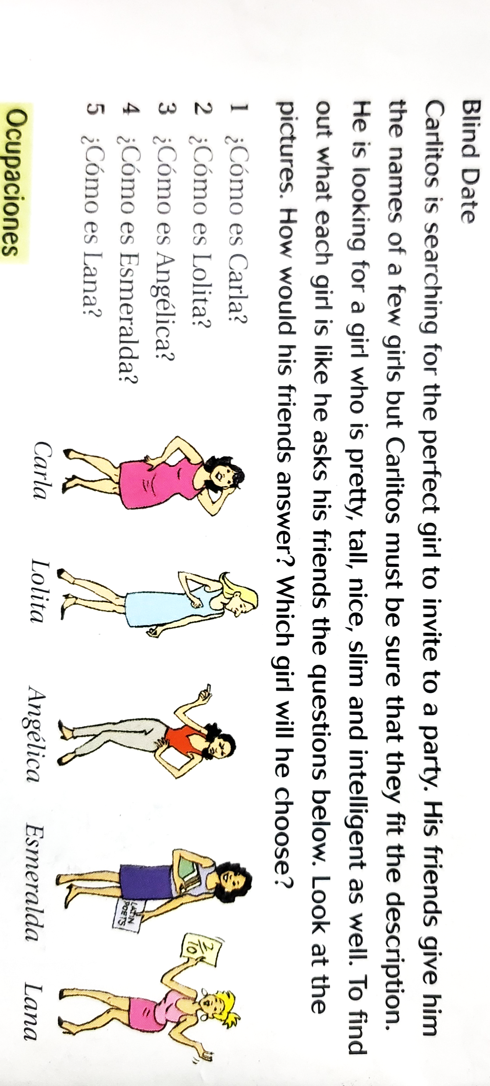
10 mins - groups of 2-3
5 mins - discussion

Slide 33
Graded Classwork- Complete the following sentences with the correct form of the adjectives in brackets and the correct form of the verb SER
Anita ____ ______ (beautiful).
Nosotras _____ _______ (strong).
Mis tías _____ ________ (talkative).
Mi amigo ____ _____ (short) y se llama Pablo.
Catalina y Roberto ____ _______ (weak).
Mis padres _____ _____ (brave).
Sabrina y José _____ ____ (skinny).
Él es mi hermano y _____ _______ (lazy).
La familia _____ ______ (artistic).
Mis Amigas ____ ______ ( intelligent)
Mi Madre ____ _________ ( beautiful)
Mis Hermanos ___ _________ (tall)
Mis Primas ____ _________ (studious)
Nosotros ________ __________ (Hard working)
Tú (boy) ____ ________ ( silly)

Slide 34
Your friend wants to know what kind of pet you have at home. What do you say to her?
Your penpal wants to know more about your parents. Describe your parents using TWO adjectives.
You are creating a profile for social media and are required to describe your personality. What do you write?
Your cousin in Cuba is curious about your Spanish teacher. Write the question he asks you.
You are having difficulty with Spanish and feel discouraged. What does your teacher say to remind you of your intelligence?
Practice Writing
-
Situations
[Agreement of adjectives]

Slide 35

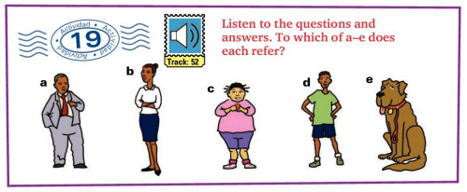
Vamos a escuchar

Slide 36
Translate the following passage into Spanish
My name is Carla. I am of medium-height, beautiful and artistic. There are four persons in my family: my parents, my brother and I. My father’s name is Julio and my mother’s name is Yanet. My father is short, fat and reserved. My mother is slim and talkative. My brother Arturo is very tall and athletic.
________
*very - muy

Slide 37
Translate the following passage into Spanish
Mi nombre es Carla. Soy de media estatura, soy bonita y artística. Hay cuatro personas en mi familia: mis padres, mi hermano y yo. Mi padre se llama Julio y mi madre se llama Yanet. Mi padre es bajo, gordo y reservado. Mi madre es delgada y habladora. Mi hermano Arturo es muy alto y atlético.
My name is Carla. I am of medium-height, beautiful and artistic. There are four persons in my family: my parents, my brother and I. My father’s name is Julio and my mother’s name is Yanet. My father is short, fat and reserved. My mother is slim and talkative. My brother Arturo is very tall and athletic.

Slide 38

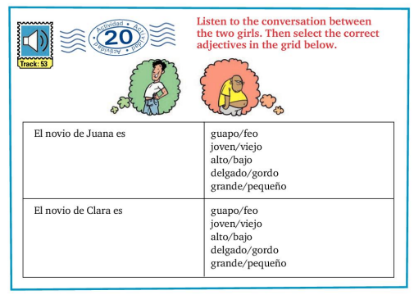
Vamos a escuchar

Slide 39
Graded Speaking HW:
¿Cómo es tu familia ?
Create an audio recording about your family. You must:
Introduce yourself
Describe yourself (state 2 things you are; 2 things you are not)
State how many persons are in your family and who they are
Name the members of your family (e.g. Mi madre se llama Ana)
Describe TWO of your family members (one male/ one female).
Your recording must not exceed 1 minute and 30 seconds.

Slide 40
¿Cómo eres
tú?
7° Grado
Semanas 2 - 4

Slide 41
Let’s get more specific!
To do this: we must review:
Yo tengo -
Tú tienes -
Él/ella/usted tiene -

Slide 43
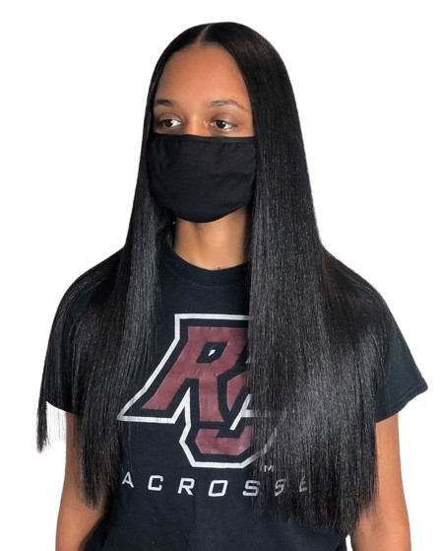
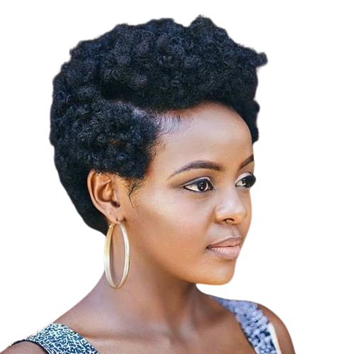
Hair Length
El pelo largo
El pelo corto

Slide 44
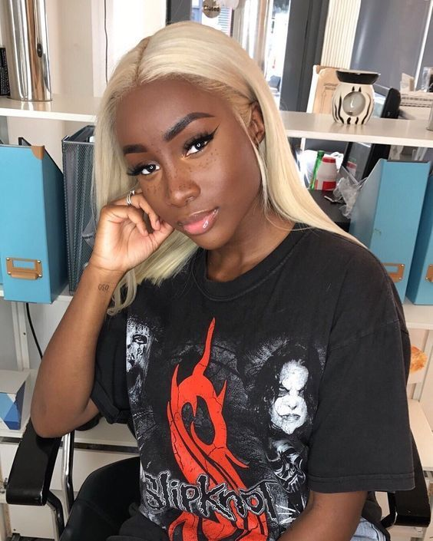
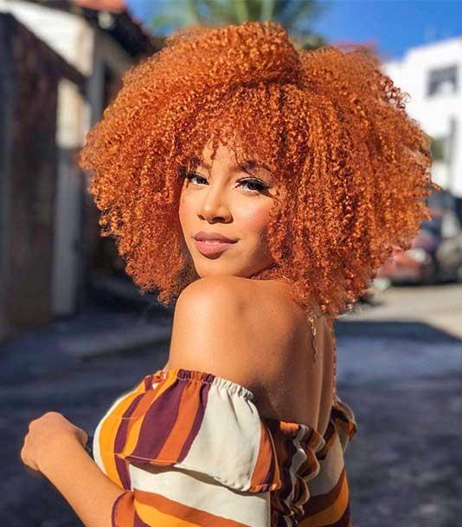
Hair Colour
El pelo rubio
El pelo pelirrojo

Slide 45
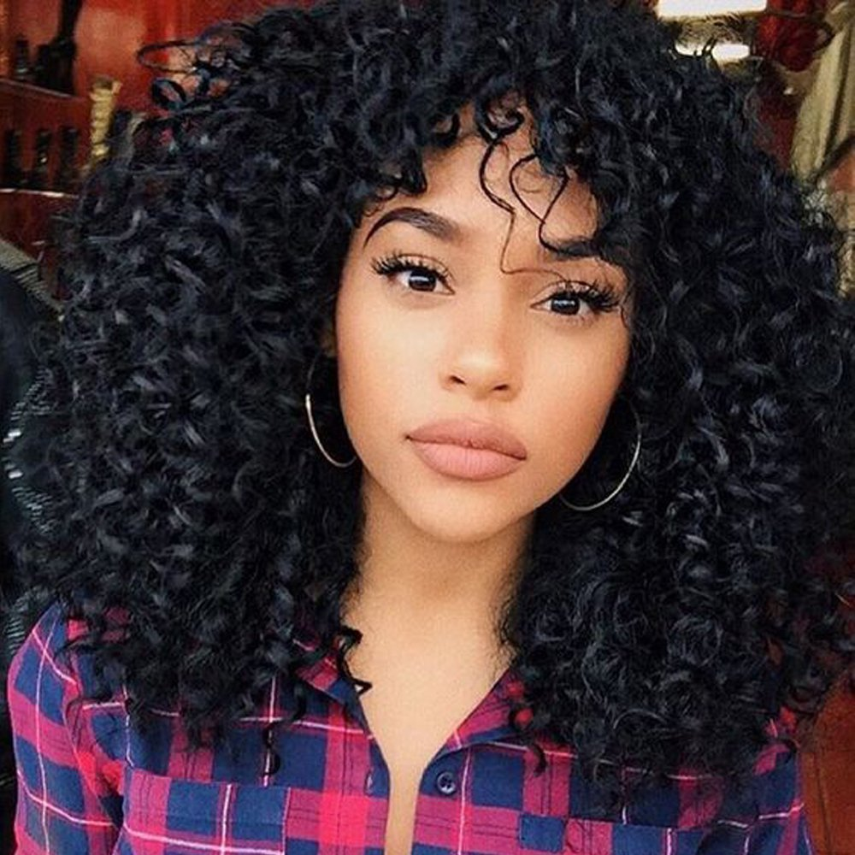
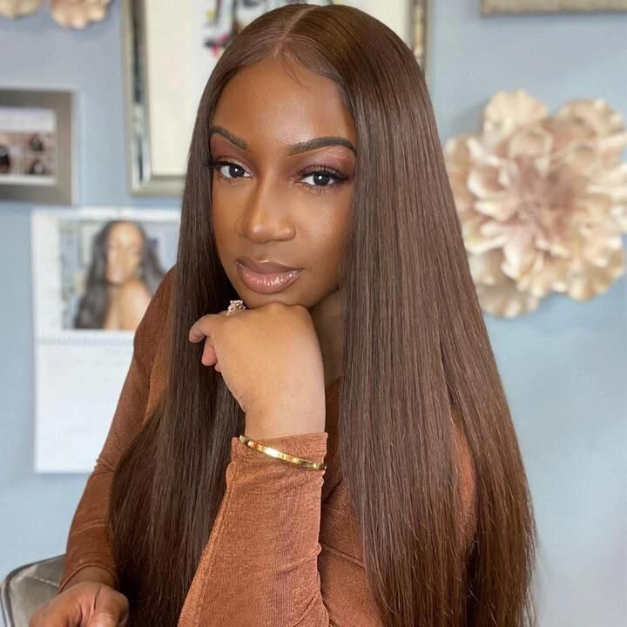
Hair Colour
El pelo negro
El pelo castaño

Slide 46
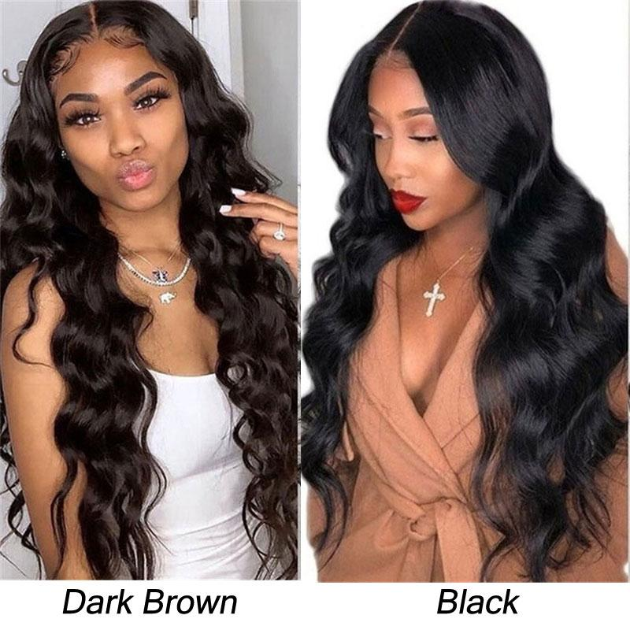
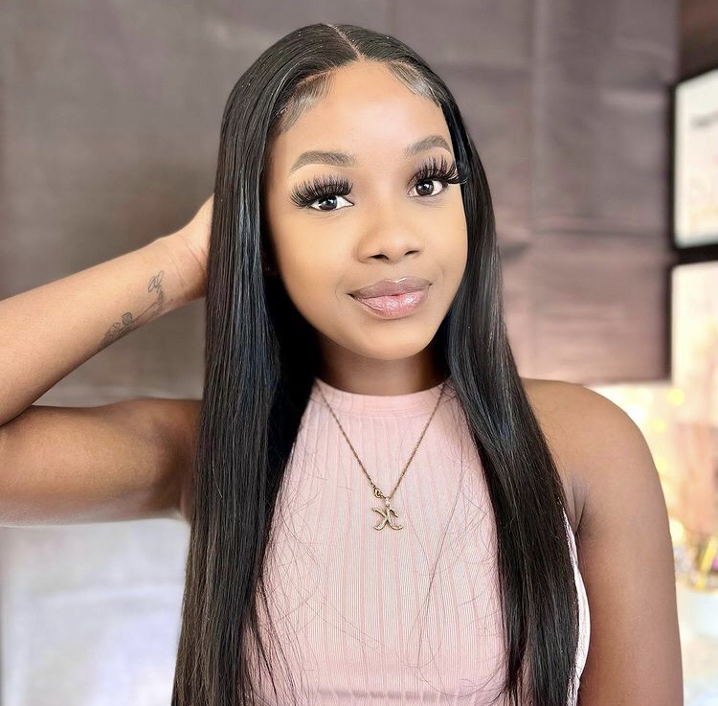
Hair Texture
El pelo liso
El pelo ondulado

Slide 47
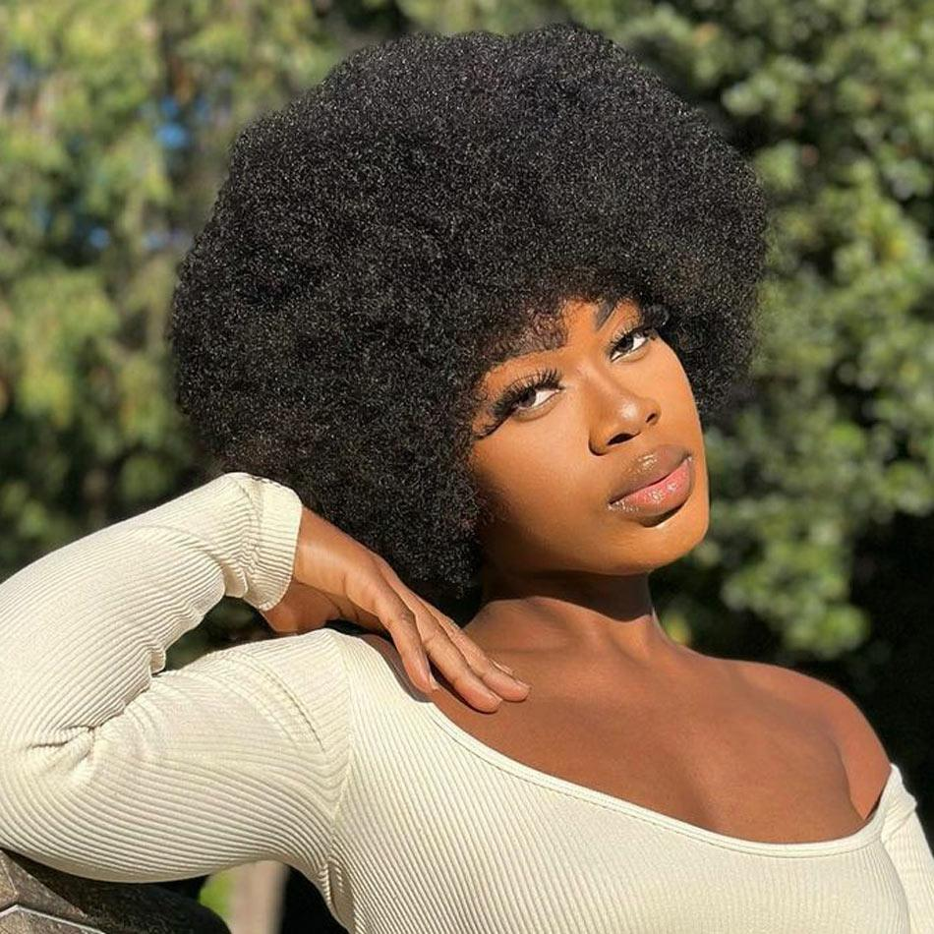
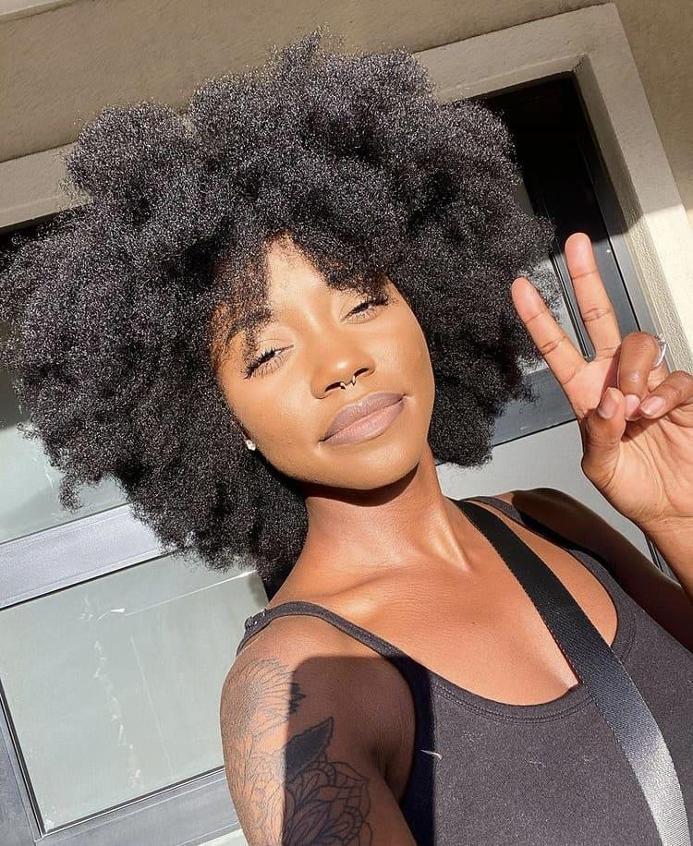
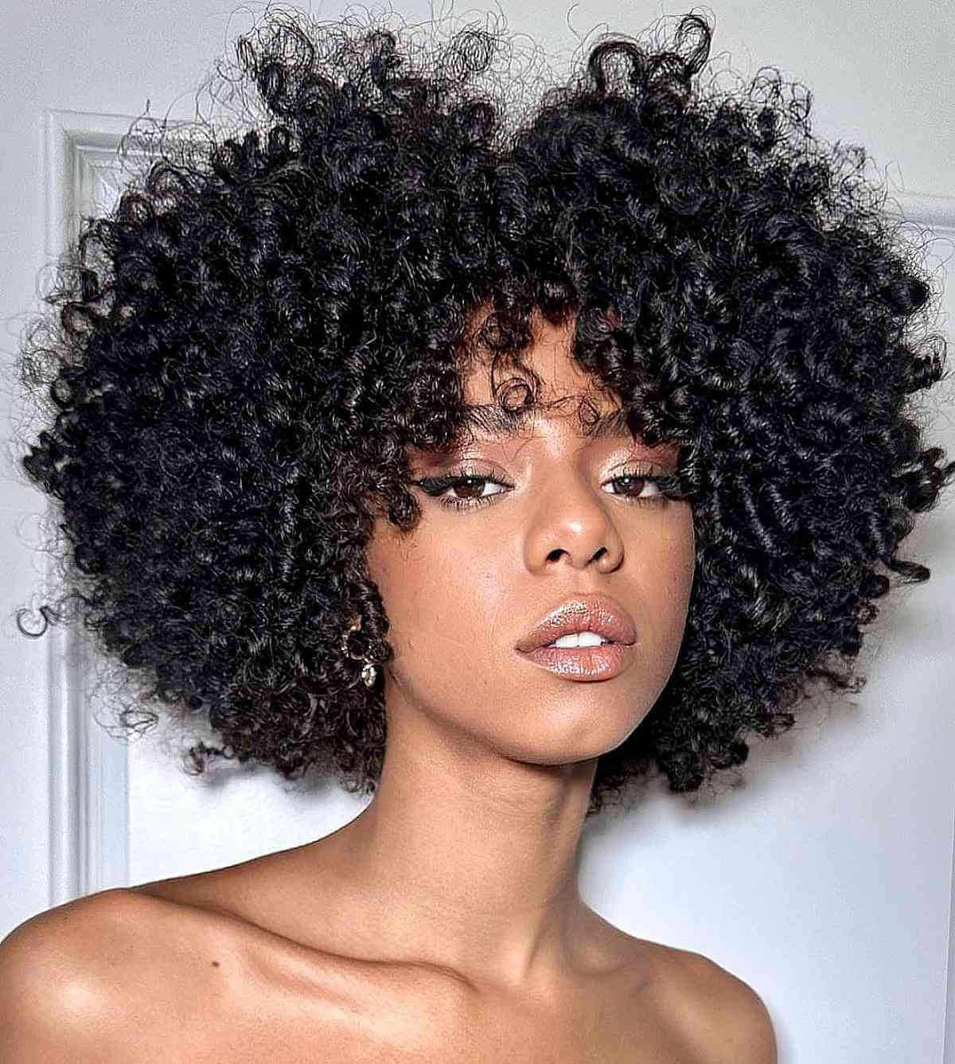
Hair Texture
You can also say: el pelo afro for more 4c type hair
El pelo rizado

Slide 48
👁️¡OJO!👁️
What do you notice about the noun and the adjective when they are directly beside each other?
Yo tengo el pelo liso.

Slide 49

Spanish adjectives:
Placement
When the noun and the adjective are beside each other in a sentence, the noun goes first and the adjective comes directly after
e.g. Juan es un chico delgado.
Juan is a slim boy.
Notes:
Prompt students to talk about agreement with nouns,

Slide 50
iA PRACTICAR!- ¿CÓMO SE ESCRIBE?
A TALL GIRL
AN INTELLIGENT STUDENT
A FAT CAT
TWO HARD WORKING MEN
THREE BIG DOGS
A HONEST BOY

Slide 51
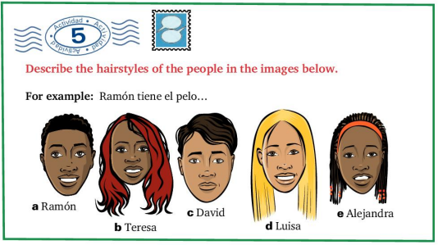
Tengo
trenzas

Slide 52
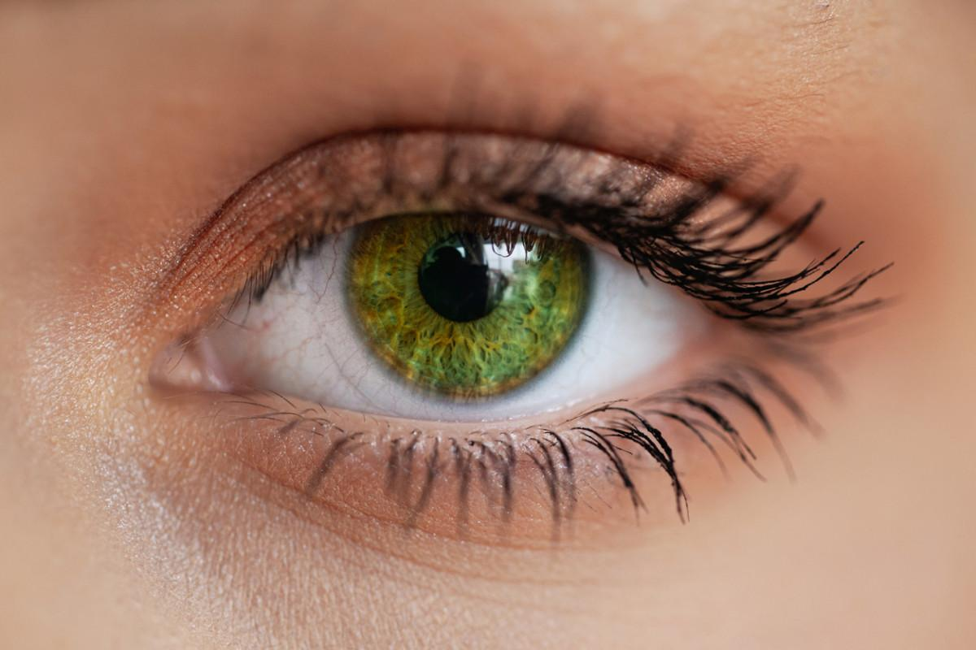
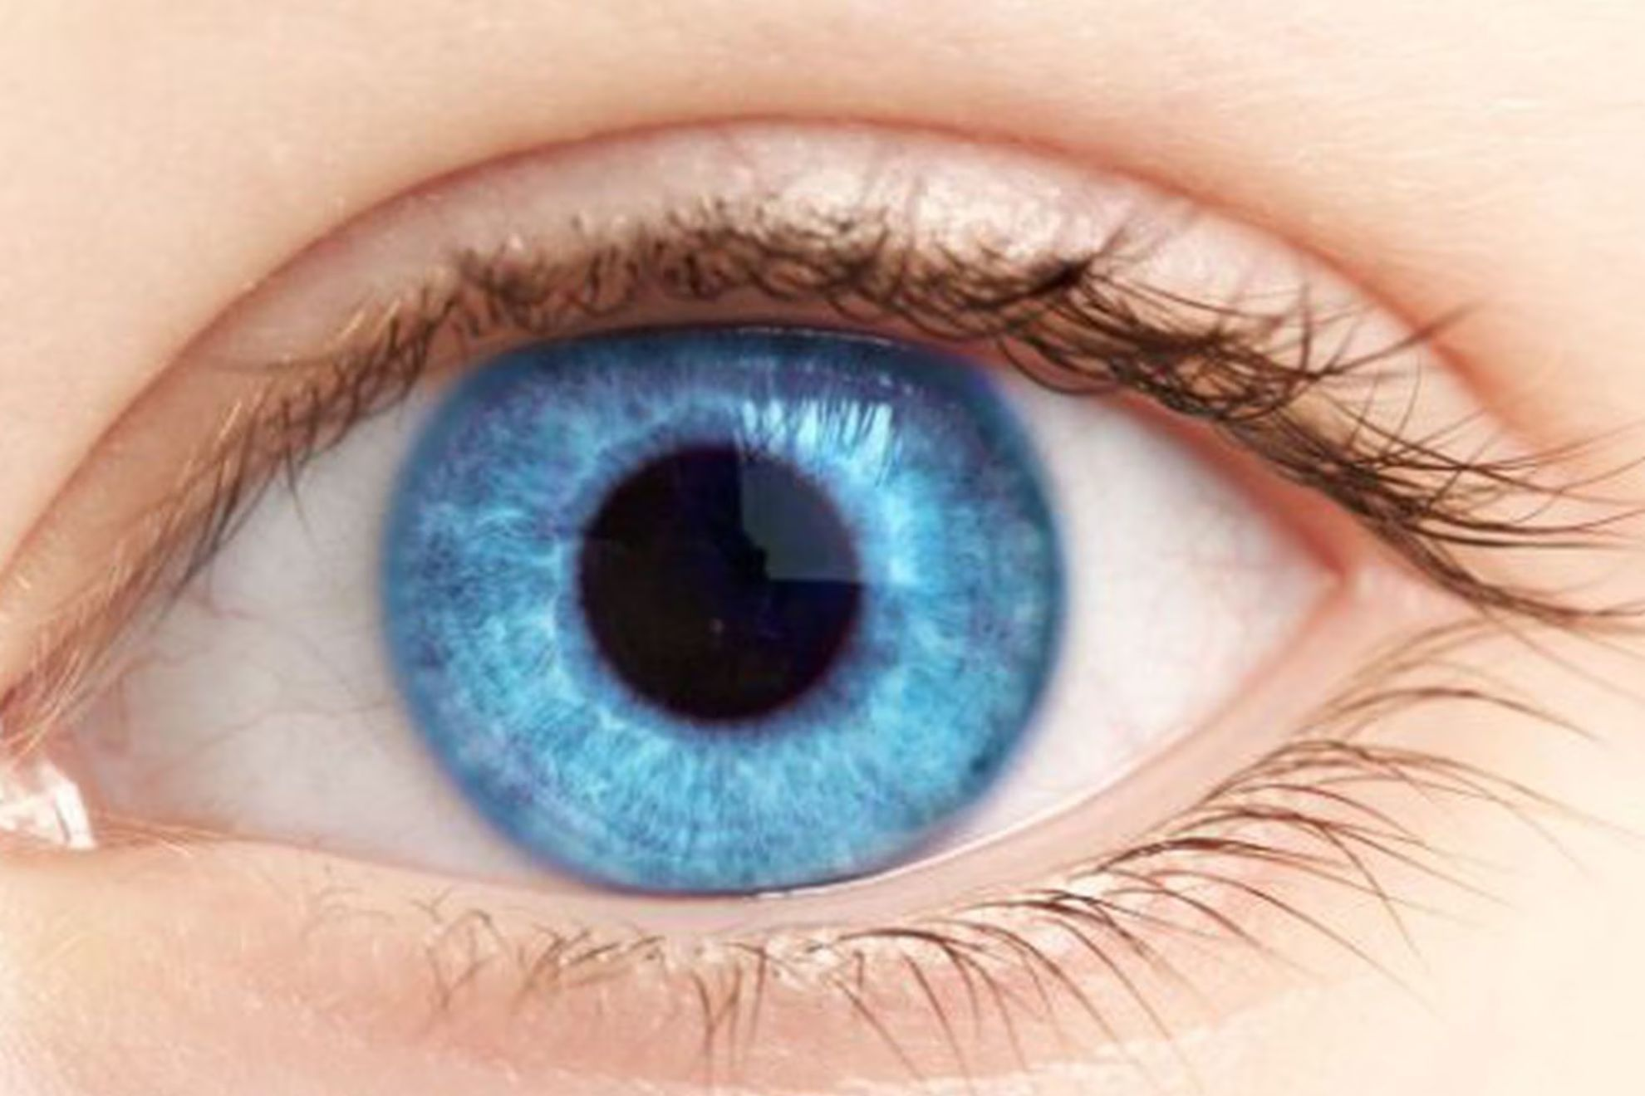
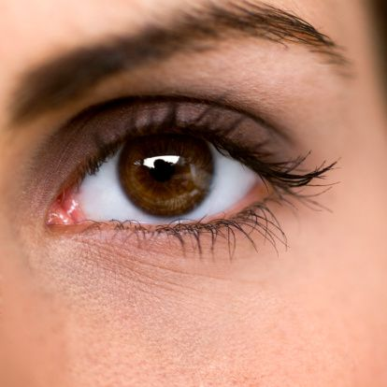
Eye colour
Los ojos verdes
Los ojos azules
Los ojos marrónes /negros

Slide 53
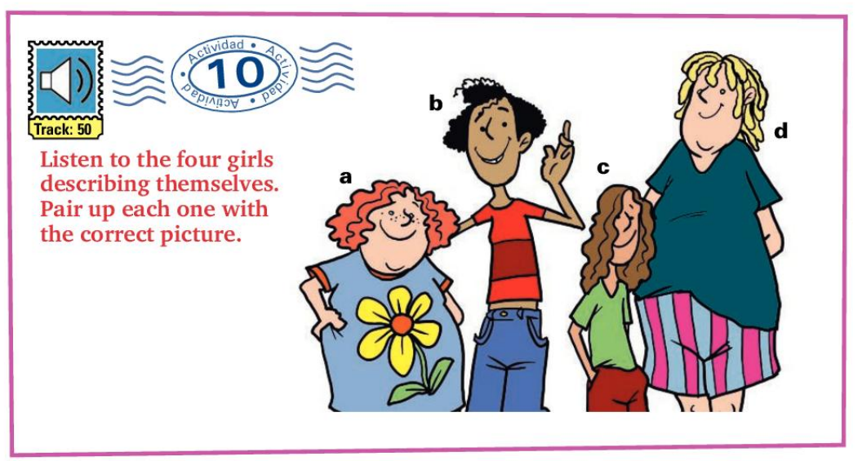

Slide 54
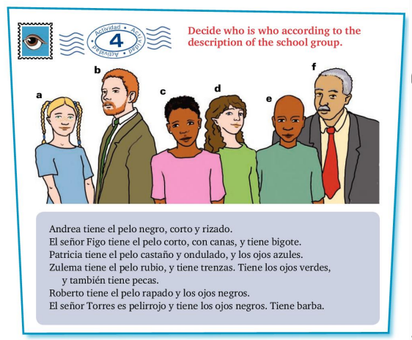
VOCABULARIO ÚTIL
CANA- GREY HAIR
BIGOTE-MUSTACHE
BARBA- BEARD
TRENZAS- PLAITS
PECAS-FRECKLES
EL PELO RAPADO- SHAVED HAIR

Slide 55
Graded Speaking HW:
¿Cómo es tu familia ?
Create an audio recording about your family. You must:
Introduce yourself
Describe yourself (state 2 things you are; 2 things you are not)
State how many persons are in your family and who they are
Name the members of your family (e.g. Mi madre se llama Ana)
Describe TWO of your family members (one male/ one female).
Your recording must not exceed 1 minute and 30 seconds.

Slide 56
Scrap book entry #3
In your scrapbooks, you are to select 5 pairs of opposites. You are to find pictures that represent the opposite adjectives that you have selected. Then, you are to write one sentences with stating the difference between the two.
Notes:
Prompt students to talk about agreement with nouns,

Slide 57
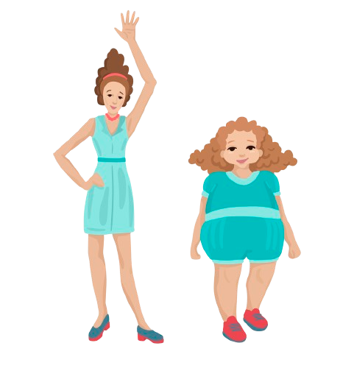
Ejemplo
Luisa es alta y delgada. Ella tiene el pelo castaño y rizado. Martha es baja y gordita y tiene el pelo rizado y rubio
Luisa
Martha

